Slide 1


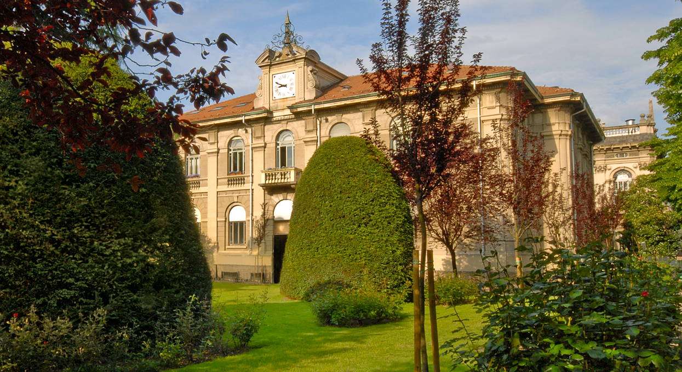

Slide 2

Cannes Yachting Festival | 09/sep/2026
MSW to Yachting Biofuels
Yachting Biorefinery Concept in Sardinia
Flavio Manenti
“Giulio Natta” Full Professor
Politecnico di Milano
Aldo Carta
Director, CIPNES (Consorzio Industriale Provinciale Nord Est Sardegna – Gallura)

Slide 3
Outline
Municipal Solid Waste (MSW) as a resource
Biogas, biomethane, biomethanol
Industrial deployment for Yachting Biofuels
Research and prototypes
Economics and carbon conversion
Yachting biorefinery concept
Sardinia’s Project
Concept extension
New circular sources

Slide 4



From waste to resource
Waste
(resource)
OFMSW
Crop
Sewage sludges, zootech.

Slide 5






From waste to resource
Waste
(resource)
Treatment
Technology
Product
OFMSW
Digestor
Combustion
Electric energy
Why biomethanol?
- Circular economy
- Carbon utilization
- Stable (storage/logistics)
- Soot reduction PM10/PM2.5
- No SOx, no NOx
- Yachting Fuel
- High-oct / High-density
- Endo / fuel cell engines
- …
Biomethane
Physical upgrading
Chemical conversion
Biofuels

Slide 6
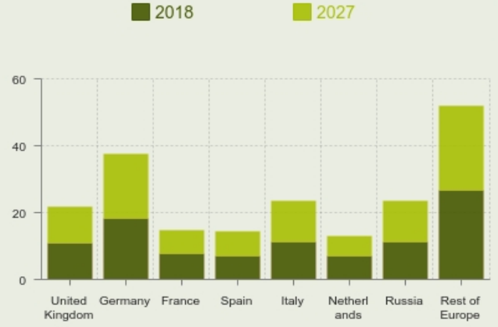
Methanol
European situation
Methanol
Base Organic Chemistry / Fuel Additive / Fuel / Hydrogen Carrier
6th
WO methanol user
2nd
EU methanol user
0
ITALIAN PLANTS?
(Source: Methanol Institute, 2024)

Slide 7
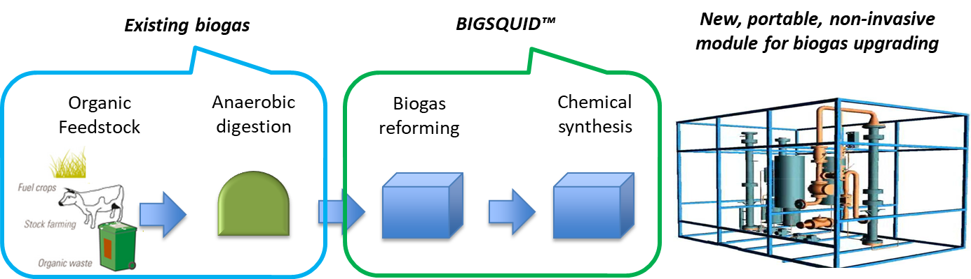
Biogas to biomethanol using MeOHmax™ technology
High yield, zero residue, self-sustainable
MeOHmax™
DR: CH₄ + CO₂ = 2 CO + 2 H₂
MeOH1: CO + 2 H₂ = CH₃OH
A. Vita et al., Methanol synthesis from biogas: A thermodynamic analysis, Renewable Energy, 2018, 118, 673–684
SMR: CH₄ + H₂O = CO + 3 H₂
MeOH2: CO₂ + 3 H₂ = CH₃OH + H₂O
Defossilized flue gases
H₂O
Bi-reforming
Synthesis
Purification
Steam
Syngas
(bio-H₂)
Yachting bio-CH₃OH
Biogas
(CH₄ / CO₂)
Combustion air
Syngas surplus

Slide 8
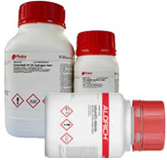
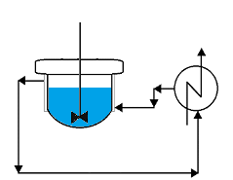

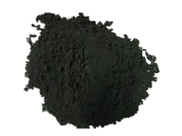
Biomethanol technology
New Catalyst
Active sites for methanol synthesis
Previtali et al., 2020
Low pressure conversion of CO2 to methanol over Cu/Zn/Al catalysts. The effect of Mg, Ca and Sr as basic promoters
Fuel, 274, 117804
Cu [15-80 %]
CZA
ZnO [15-50 %]
Maintain the Cu in optimal dispersion
Al₂O₃ [4-30 %]
Increase surface area and copper dispersion
_{Co-precipitation synthesis}
Synthesized
product
Calcined
T=350°C
6h
Cu(NO₃)₂·2.5H₂O
Preheated water
Zn(NO₃)₂·6H₂O
Al(NO₃)₃·9H₂O
Na₂CO₃ - pH7 - 70°C - 1h

Slide 9
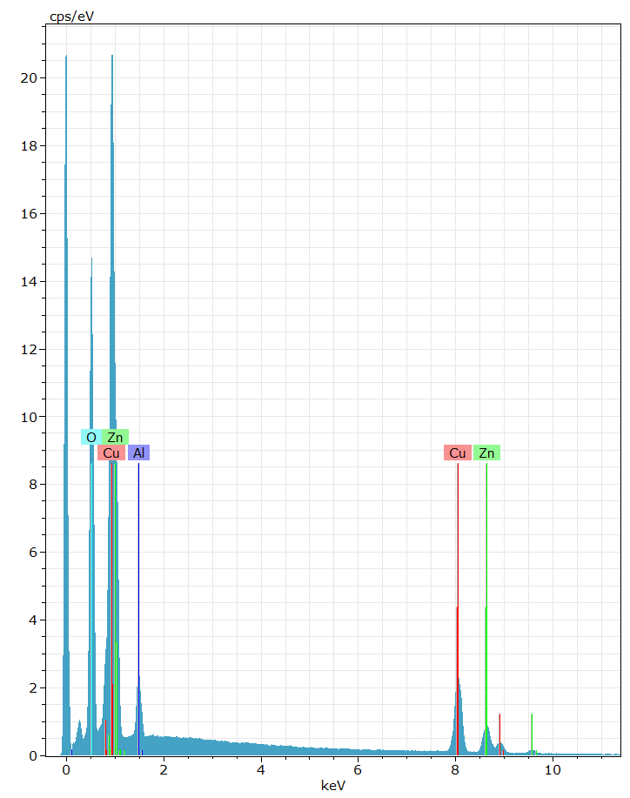

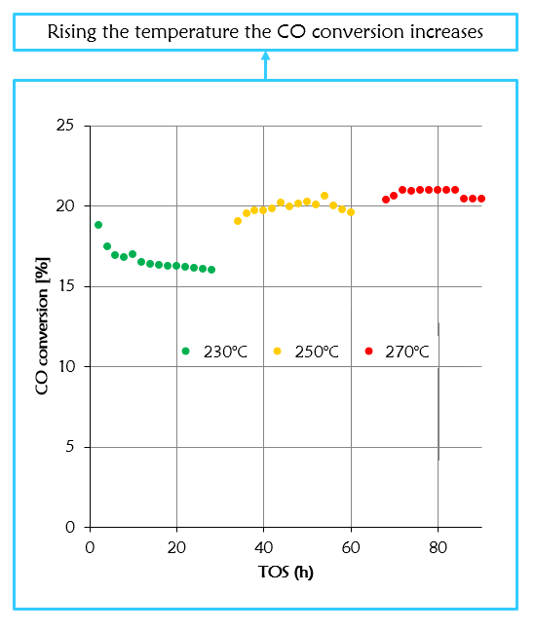
Biomethanol technology
New Operating Conditions
SEM-EDX synthesized catalyst
Al
O
Temperature influence
Cu
Zn
TEM comparison
200 nm
Synthesized
Commercial
200 nm

Slide 10
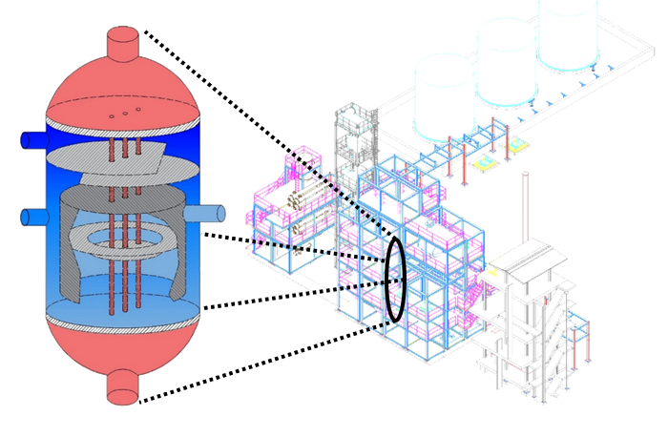
Biomethanol
New Reactors (DZMR™) and Unit Operations

Slide 11
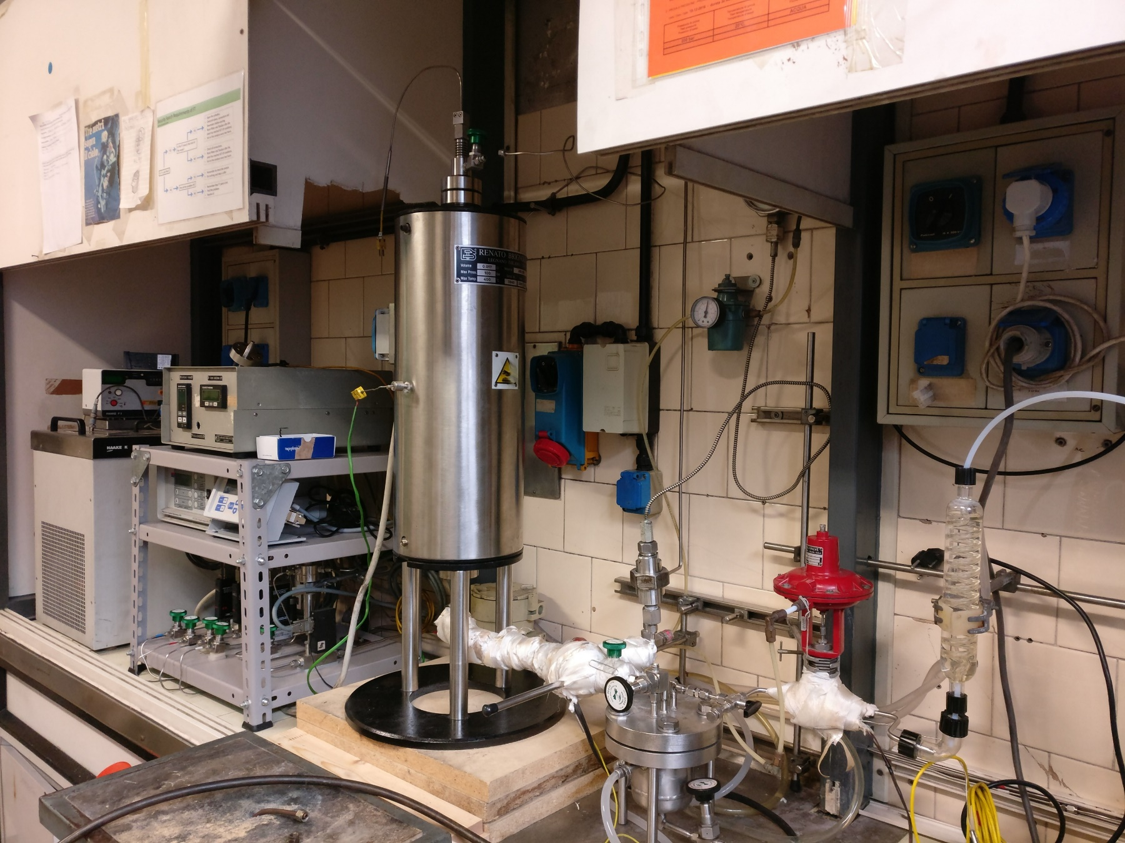
Biomethanol
Bench-scale Validation
Reactor
Feed composition control
Separation and analytic zone

Slide 12
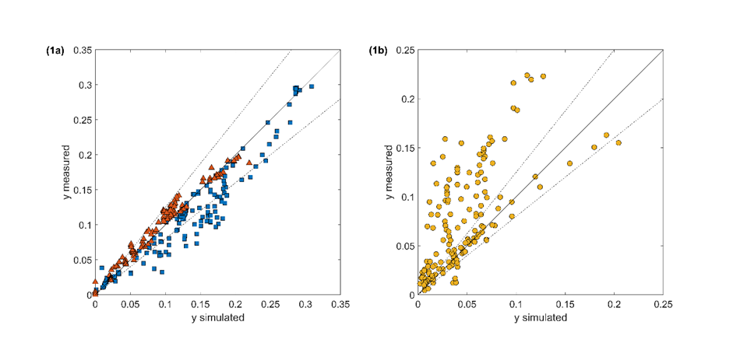
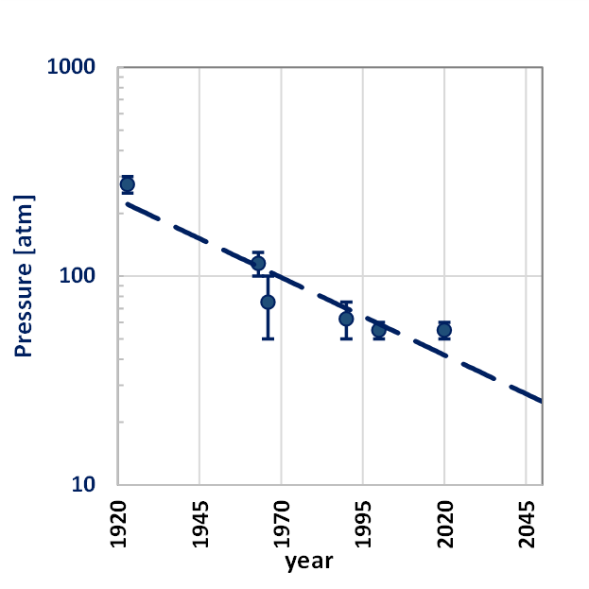
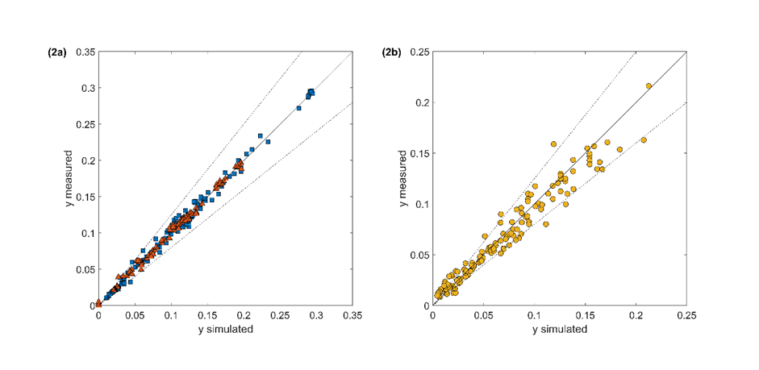
Biomethanol
Industrial deployment
Bisotti et al., 2021
Century of Technology Trends in Methanol Synthesis: Any Need for Kinetics Refitting?
Industrial & Engineering Chemistry Research, 60, 44, 16032–16053
Bisotti et al., 2022
Impact of Kinetic Models on Methanol Synthesis Reactor Predictions: In Silico Assessment and Comparison with Industrial Data
Industrial & Engineering Chemistry Research, 61, 2206–2226

Slide 13
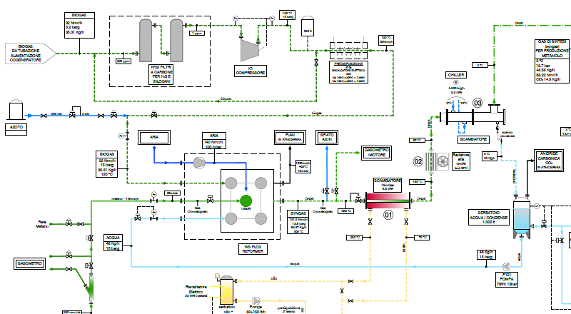
Biomethanol process
Basic Engineering Design Package

Slide 14
Economics
Technology* | Production | Specific value | Income (8400 h/y) | Incentive (Italy) | Total income | Process CAPEX
Biogas | 0.99 MWh | 0.11 €/kWh | 0.924 M€/y | 0.12 €/kWh | 1.932 M€/y | 5.0 M€ Baseline
Bio-methane | 2.00 kt/y | 0.30 €/kg | 0.600 M€/y | 0.60 €/kg | 1.800 M€/y | 5.0 M€
Bio-H2 | 0.50 kt/y | 2.00 €/kg* | 1.000 M€/y | - | 1.000 M€/y | 12.0 M€
MeOHmax™ Bio-MeOH | 4.00 kt/y | 0.50 €/kg* | 2.000 M€/y | 0.43 €/kg | 3.720 M€/y | 15.0 M€
BIGSQUID Bio-DME | 2.25 kt/y | 0.615 €/kg* | 1.384 M€/y | 0.485 €/kg | 2.475 M€/y | 9.0 M€
*AVG fossil price

Slide 15
Environmental defossilization
Technology | CO₂ release | Carbon efficiency | Classification
Biogas | 7.852 kt/y | - Baseline | Carbon neutral
Bio-methane | 4.711 kt/y | -40% | Carbon negative
Bio-H2 | 7.852 kt/y | - | Carbon neutral
MeOHmax™Bio-MeOH | 0.942 kt/y | -88% | Carbon negative

Slide 16
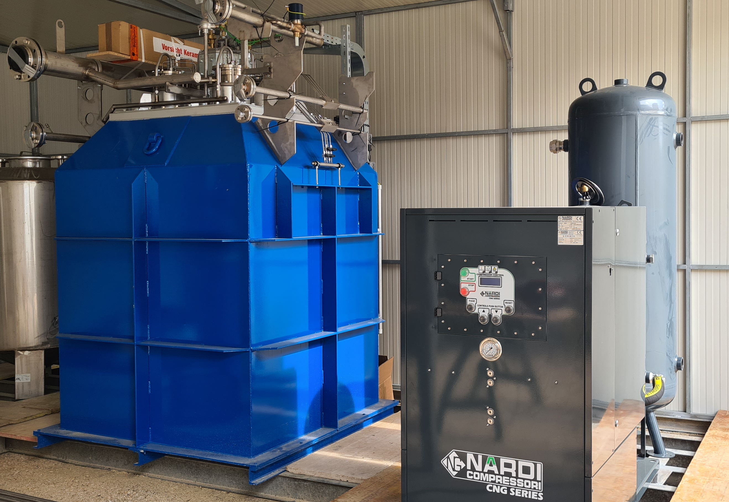

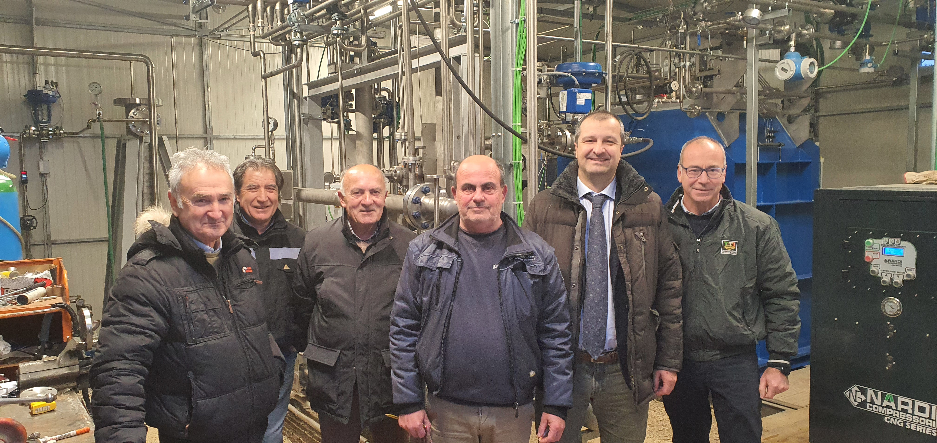
Industrial demo-prototype
Operating since Q2/2022
(Picture: construction phase)
Operating plants (0.15 MWe; 1 MWe)
(Picture: start-up)
EPC
CLIENT
LICENSOR
O&M
AUTOM
INSTRUM

Slide 17
Yachting Biorefinery Concept
Sardinia’s Project
2026 – Dedicated Regional Decree to favor Yachting Sector defossilization

Slide 18

Yachting biorefinery
The case of Sardinia
Biogas plant

Slide 19
Yachting biorefinery
The case of Sardinia
Biogas plant

Slide 20

CIPNES Project
First Hub (Worldwide) for Yachting Biofuels
Biogas plant
Biomethanol plant
Yachting refueling
Size: 3-6000 t/y
Potential: 30’000+ t/y
Current: FEED done

Slide 21
CIPNES project
Replicability
Biogas plant
Biomethanol plant
Yachting refueling

Slide 22
CIPNES project
Replicability
Biogas plant
Biomethanol plant
Yachting refueling

Slide 23
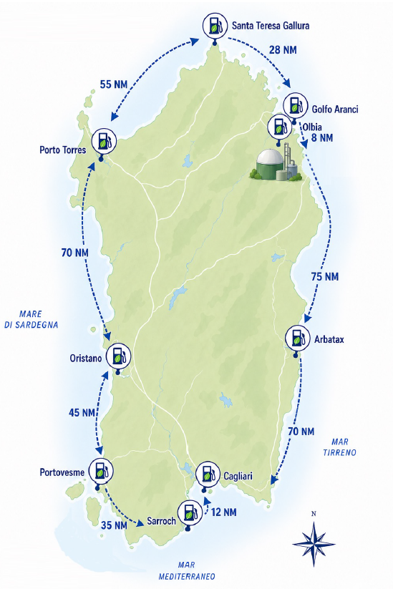

CIPNES project
Replicability
Biogas plant
Biomethanol plant
Predisposed harbors

Slide 24
Not only OF-MSW…
Other sources

Slide 25
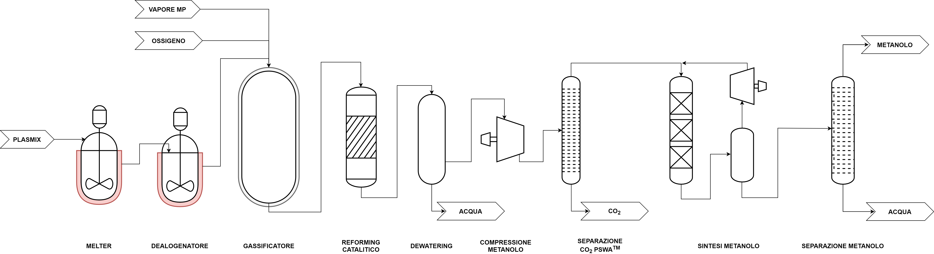
Plastic wastes into recycled methanol
1t
plasmix
1t
methanol
Prifti, Galeazzi, Manenti
Design and Simulation of a Plastic Waste to Methanol Process: Yields and Economics
Industrial and Engineering Chemistry Research
2023, 62(12), pp. 5083–5096

Slide 26
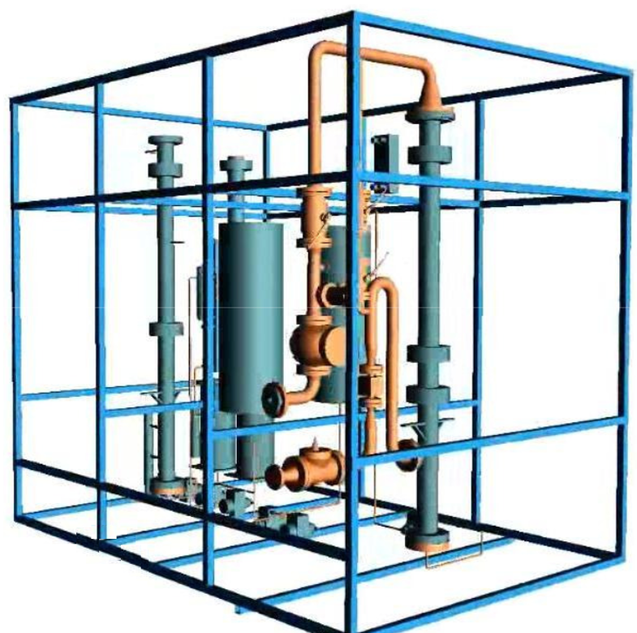



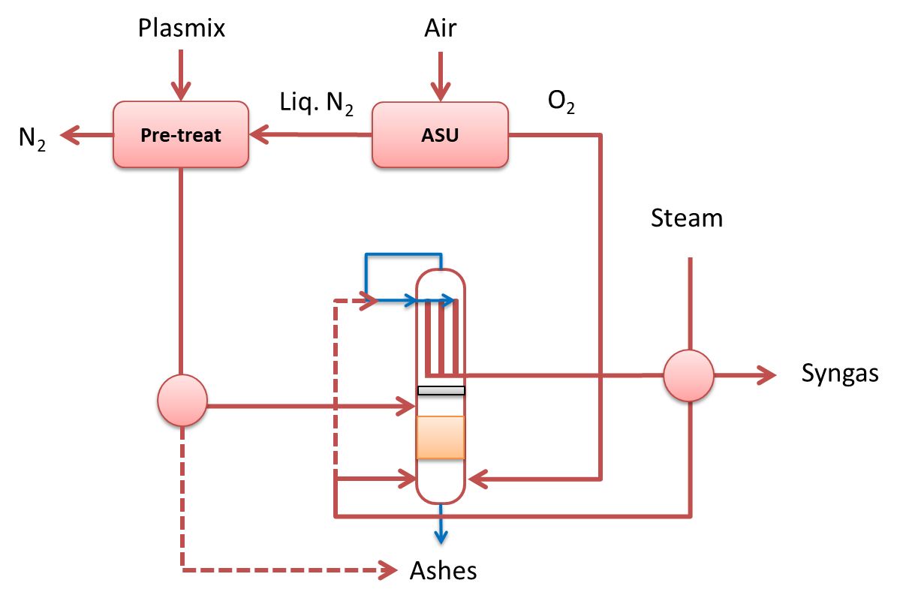
Additional available circular feedstocks
Existing biogas
BIGSQUID™
New, portable, non-invasive module for biogas upgrading
Organic Feedstock
Anaerobic digestion
Biogas reforming
Chemical synthesis
Rec-MeOH
Plastic waste

Slide 27





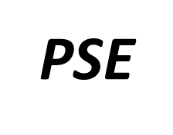



Thanks for the kind attention
Flavio Manenti
Full Professor of Chemical Plants and Operations (Milano, ITA)
Director of the Centre for SuPER, Politecnico di Milano (Milano, ITA)
Ministry Delegate, Ministero dell’Ambiente e della Sicurezza Energetica (MASE, Roma, ITA)
Alexander von Humboldt Stiftung Senior Scientist, AvH Stiftung (Berlin, GER)
POLITECNICO DI MILANO
Dipartimento di Chimica, Materiali e Ingegneria Chimica "G. Natta"
Sustainable Process Engineering Research (SuPER) Centre
Piazza Leonardo da Vinci, 32, 20133 Milano, ITALY
(Phone) +39.(0)2.2399.3273
(Email) flavio.manenti@polimi.it
WELCOME… - (Web) https://super.chem.polimi.it

Slide 28
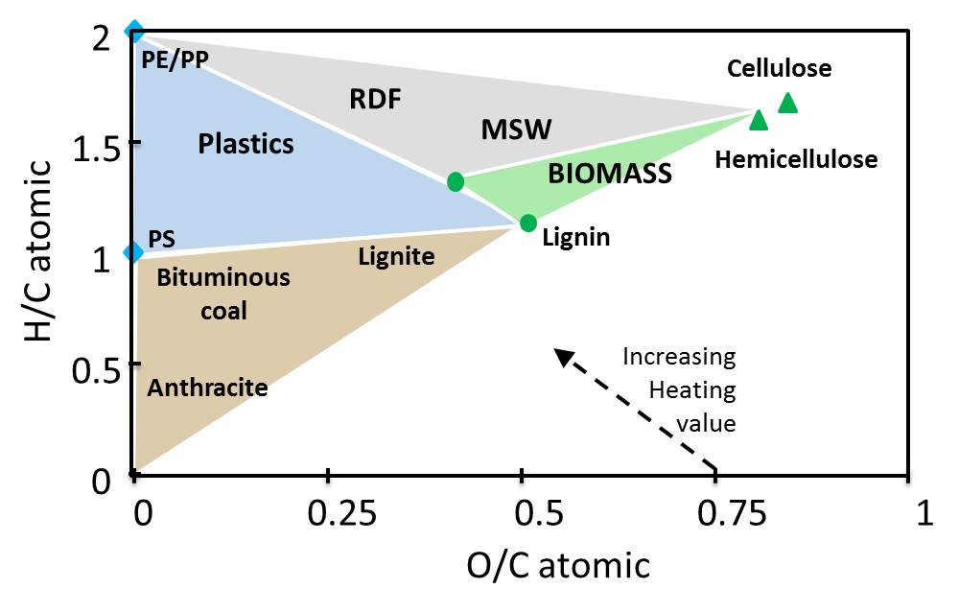
Circular processes
Ranzi, Faravelli, Manenti, Pyrolysis, Gasification, and Combustion of Solid Fuels
Advances in Chemical Engineering, 49, 1-94, 2016

